Slide 1
Student Management System
A GUI-based Application using Python and SQLite

Slide 2
STUDENT MANAGEMENT SYSTEM
DEVELOPER: CHARLES DIEGO CHIMA
GITHUB: GITHUB.COM/CHARLES1855/STUDENT-MANAGEMENT-PROJECT

Slide 3
Overview
A GUI-BASED APPLICATION DEVELOPED IN PYTHON TO MANAGE STUDENT RECORDS EFFICIENTLY.
ADMIN CAN MANAGE STUDENTS AND COURSES
CORE FUNCTIONALITIES: ADD, UPDATE, DELETE, AND SEARCH STUDENT RECORDS; USER AUTHENTICATION; MODULAR CODE

Slide 4
Modules Used
GUI FRAMEWORK: TKINTER
ttk - Themed widgets like Treeview
sqlite3 - Database backend
messagebox - Alert messages
MANAGE - Custom module for DB functions

Slide 5
Login System
Secure login for admin access
Login Credentials:
Username: Admin
Password: ********
Notes:
login() Retrieves the entered username and password. Compares them with predefined admin credentials (ADMIN_USERNAME, ADMIN_PASSWORD).If matched, it shows a success message and navigates to the dashboard. Otherwise, it shows an error message.
logout() Asks for confirmation to log out. If confirmed, it clears all frames and returns to the login screen.

Slide 6
Window Layout
Main window: 1890x1080 pixels
Light teal background
Frames: login, dashboard, student, course

Slide 7
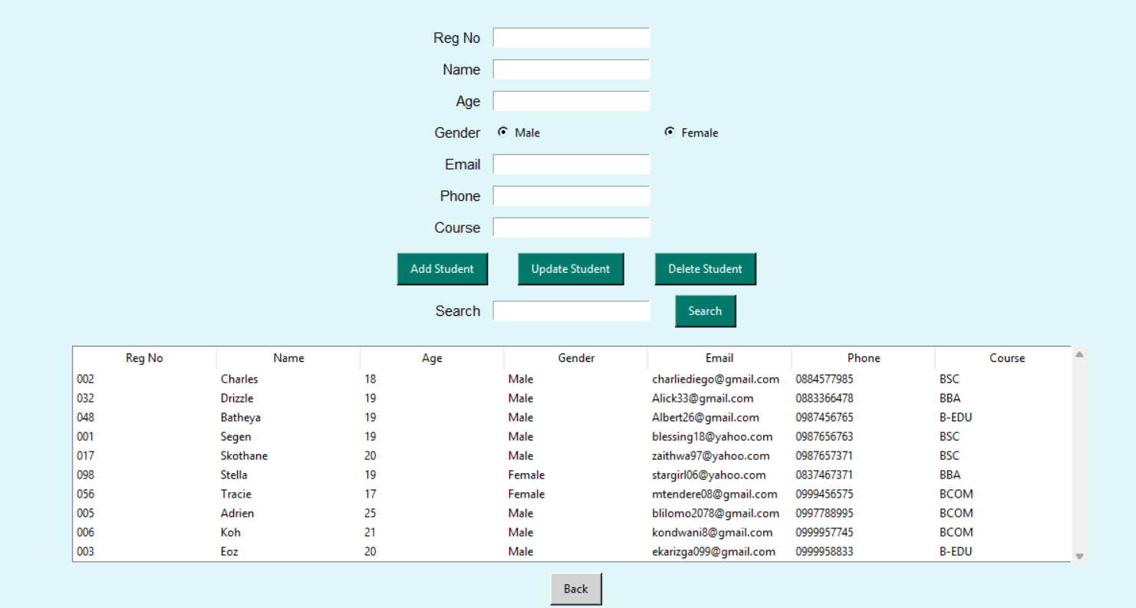
Dashboard
Manage Students
Notes:
show_dashboard() Clears the screen and displays the main dashboard with buttons to manage students or courses.

Slide 8
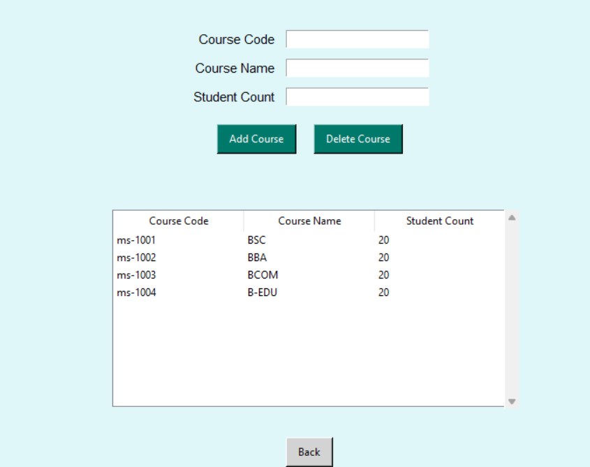
DASHBOARD
MANAGE COURSE

Slide 9
Student Management
Add, update, delete students
Search and view student records
Displayed in Treeview widget

Slide 10
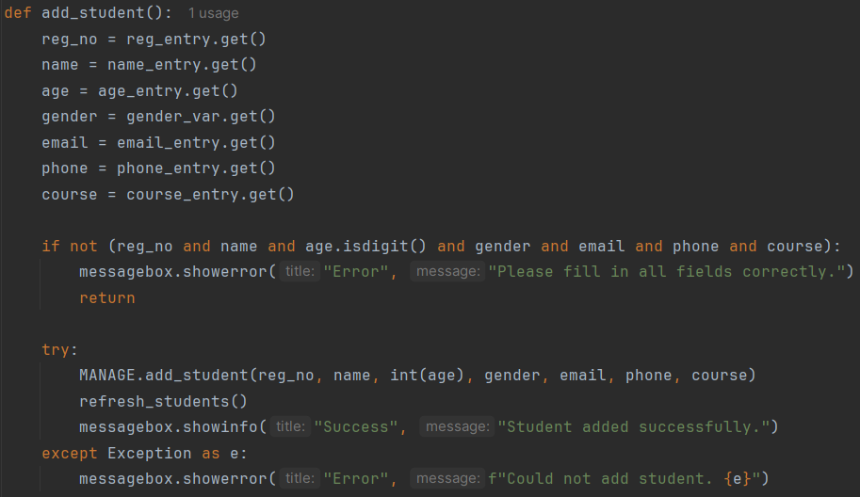
Student Management
FUNCTION TO ADD STUDENTS
Notes:
add_student()
Gathers data from input fields.
Validates that fields are filled correctly (e.g., age.isdigit()).
Calls MANAGE.add_student() to add to the database.
Refreshes the table and shows success or error message.

Slide 11
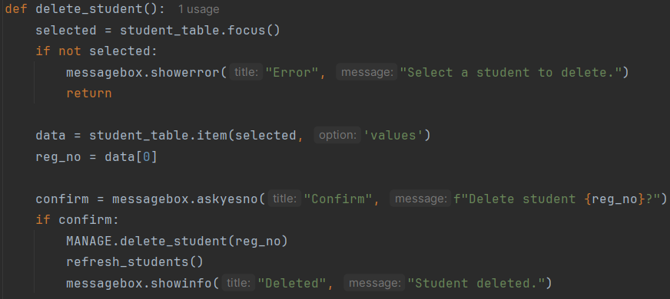
Student Management
FUNCTION TO DELETE STUDENTS
Notes:
delete_student()
Gets the selected student and confirms deletion.
Calls MANAGE.delete_student() and refreshes the table.

Slide 12
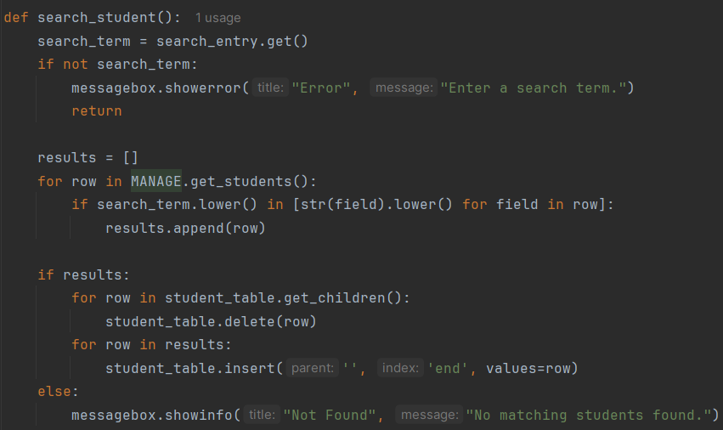
Student Management
FUNCTION TO SEARCH STUDENTS
Notes:
search_student()
Searches for the term across all fields for all students.
Updates the table to show only matching results.

Slide 13
COURSE MANAGEMENT
ADD AND DELETE COURSES
VIEW COURSES IN TREEVIEW
FIELDS: CODE, NAME, STUDENT COUNT

Slide 14
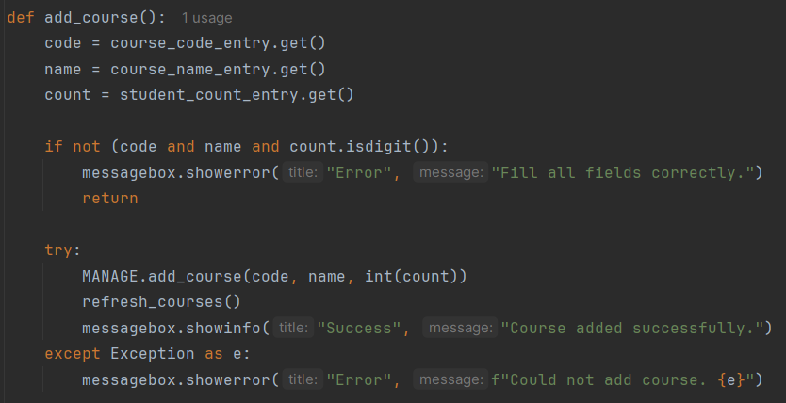
Course Management
FUNCTION TO ADD COURSES
Notes:
add_course()
Takes input from course fields.
Validates them and calls MANAGE.add_course() to store in the database.
Refreshes the course list.

Slide 15
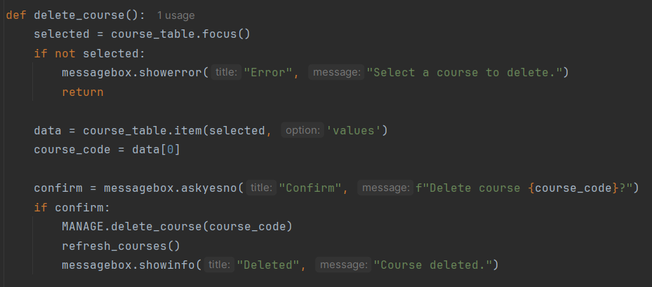
Course Management
FUNCTION TO DELETE COURSES
Notes:
delete_course()
Gets the selected course and confirms deletion.
Calls MANAGE.delete_course() and refreshes the table.

Slide 16
Database Schema
SQLITE DATABASE
TABLE: STUDENTS - REG_NO, NAME, AGE, GENDER, EMAIL, PHONE, COURSE
TABLE: COURSES - COURSE_CODE, COURSE_NAME, STUDENT_COUNT

Slide 17
Database Functions
ADD_STUDENT(), UPDATE_STUDENT(), DELETE_STUDENT(), GET_STUDENTS()
ADD_COURSE(), UPDATE_COURSE(), DELETE_COURSE(), GET_COURSES()
Notes:
add_student(...)
Inserts a new student record into the students table using SQL.
update_student(...)
Updates the existing student record based on registration number.
delete_student(reg_no)
Deletes a student record by registration number.
get_students()
Fetches and returns all student records from the database.

Slide 18
Error Handling
INPUT VALIDATION
ERROR MESSAGES FOR INCORRECT INPUT
CONFIRMATION DIALOGS FOR DELETE AND LOGOUT

Slide 19
Suggestions for Improvement
THE PROJECT OFFERS A BASIC AND EFFECTIVE WAY TO MANAGE STUDENT DATA.
USE PASSWORD HASHING
ENABLE EXPORT TO CSV/PDF
ADD GPA CALCULATOR
INCLUDE ADVANCED FILTERING OPTIONS

Slide 20
THE END
THANK YOU
ANY QUESTIONS?

